Slide 1
Highly Skilled Workforce and the Intersection with Cooperative Education Teachers
March 2018

Slide 2
RENEWED GOALS
Achieving Excellence
Ensuring Equity
Promoting Well-Being
Enhancing Public Confidence
Achieving Excellence
“To achieve success, Ontario will…
Provide new online learning and professional development opportunities for both teachers and students, particularly those in rural and remote communities, including opportunities for virtual cooperative education placements”. (p.13)
“To achieve success, Ontario will…
Partner with community organizations and businesses to provide students with more experiential learning opportunities…” (p.19)
Notes:
Ontario’s Career Kick-Start Strategy - the government is partnering with labour unions and employers to support sectoral training
Expand SHSM
Experience Ontario will continue
OYAP expansion
Update and modernize the apprenticeship program
Encourage high schools and colleges to work together.

Slide 3
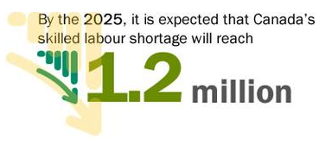
The Premier’s Expert Panel
on the Highly Skilled Workforce
Ontario’s continued economic prosperity depends on a highly skilled workforce that is diverse, adaptable and innovative.
A highly skilled and adaptable workforce will be the foundation of Ontario’s competitiveness and prosperity. A diverse and vibrant workforce is an asset that provides unique perspectives, fosters global competitiveness and creates opportunities for all Ontarians.
Notes:
People from a young age are aware of all of the opportunities available to them, and they are given the opportunities to develop competencies, and skills, and to have hands-on experiences that allow them to pursue their passion, no matter what pathway they choose to take.
People feel empowered to take responsibility for their own educational and career decisions and are committed to developing their own talent and skills at all stages of life and learning.
Building the Workforce of Tomorrow, p. 10

Slide 4
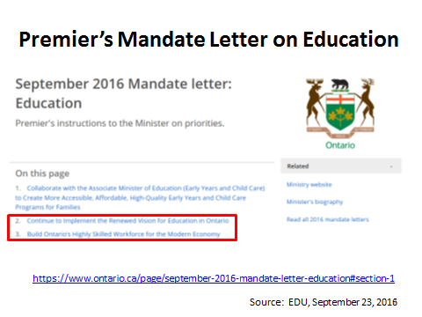
Notes:
Initiatives Committee

Slide 5
Multiple learning pathways
Cooperative Education Teachers
Supporting pathway and transition planning beyond high school
Personalized Learning
Multiple Learning Pathways
Connections with community members and supports
Meeting students where they are at
Provide students with exposure to role models
Provide students with positive examples of traditional and non-traditional trades
Understand career planning and navigation is no longer a linear process

Slide 6
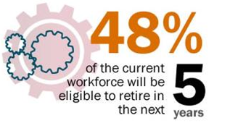
Cooperative Education
The new revised cooperative education curriculum and policy implementation document is planned for implementation training in Spring 2018 and full implementation in September 2018.

Slide 7
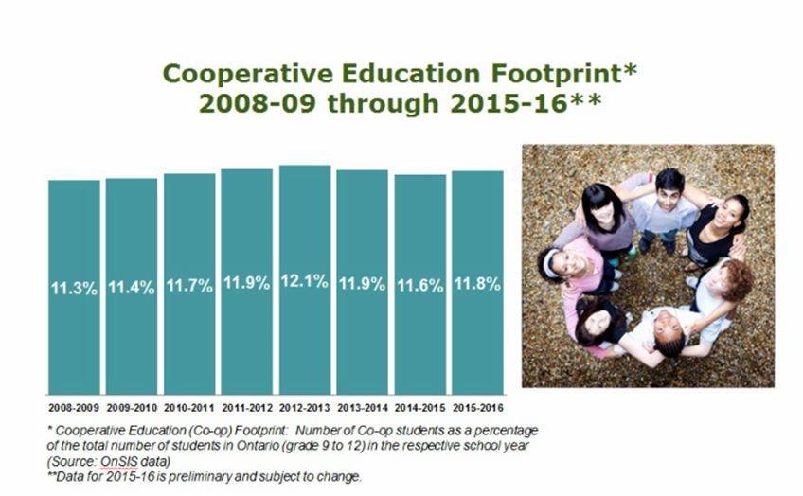

Slide 8
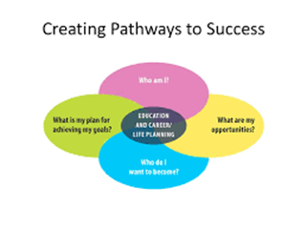
Points of Intersection
Students
Notes:
Modernization of apprenticeship
Pathways to apprenticeship

Slide 9
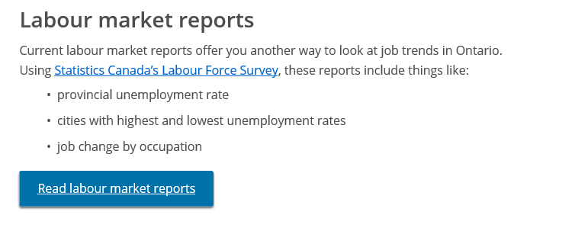
Ontario.ca/Labour Market

Slide 10
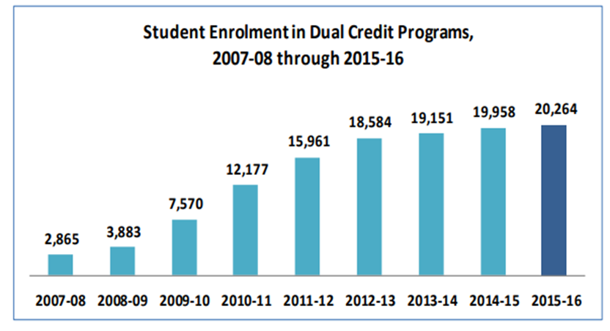
Dual Credits

Slide 11
Dual Credits

Slide 12
How are/will you measure your impact?
To what extent do I, as a co-op teacher:
promote “greater awareness and a real understanding of all the career possibilities” (HSW);
enable students to leave us with “a clear sense of self and a plan for their initial postsecondary destination” (CPS);
provide our students with “confidence in their ability to implement and revise or adapt their plan throughout their lives as they and the world around them change” (CPS);
Share with students the intersecting pathways and opportunities of SHSM, Dual Credits and OYAP.

Slide 13
Feedback

