Slide 1








The College Sector

Slide 2
EDUCATIONAL CHOICES
Ontario college system
  Created in 1967
  In the beginning colleges were known for trades and technology
Ontario university system
  Is much older...
  University of Toronto founded in 1827
  Known for academic learning

Slide 3
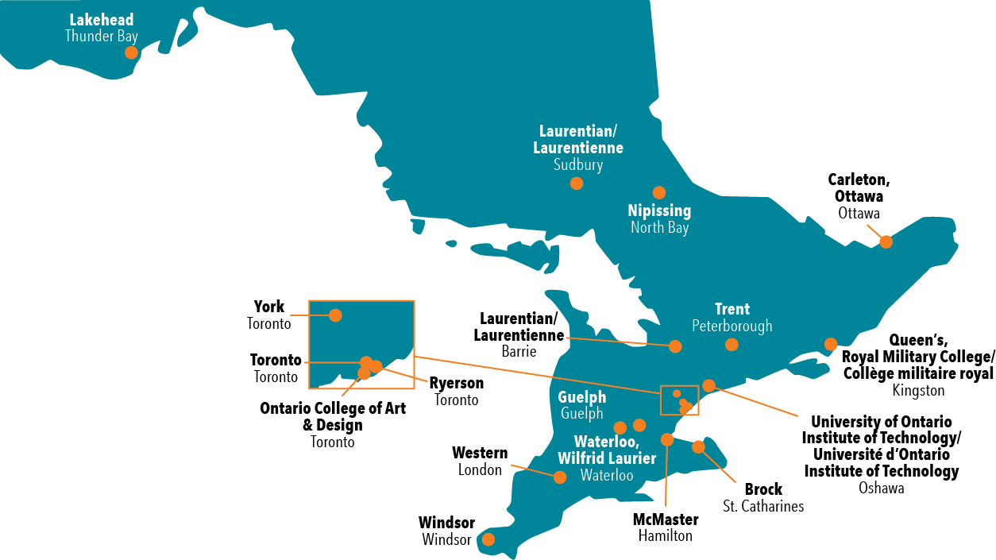
ONTARIO UNIVERSITIES
21 universities specializing in different fields and professional programs

Slide 4

ONTARIO UNIVERSITIES
Universities offer:
  Three- and four-year undergraduate degrees
Professional programs:
  Dentistry
  Medicine
  Engineering
  Law
  Education

Slide 5

ADMISSION REQUIREMENTS
Degree:
  Six (U) or (U/C) level credits
  Entrance grades will vary institution to institution, program to program
  Declaring a major, minor, or specialist

Slide 6
WHAT YOU EARN
Three-year (general) degree
Four-year (honours) degree
Masters
Professional Degree: LLB, MD
Doctorate
Full course load: five courses a semester plus labs (for certain degrees)

Slide 7

The evolution of College
What college used to be:
Colleges offered hands-on, skills-based training; universities offered a more academic-based curriculum, training for professional careers.
What college is now:
Both colleges and universities offer academic learning blended with practical experience.

Slide 8
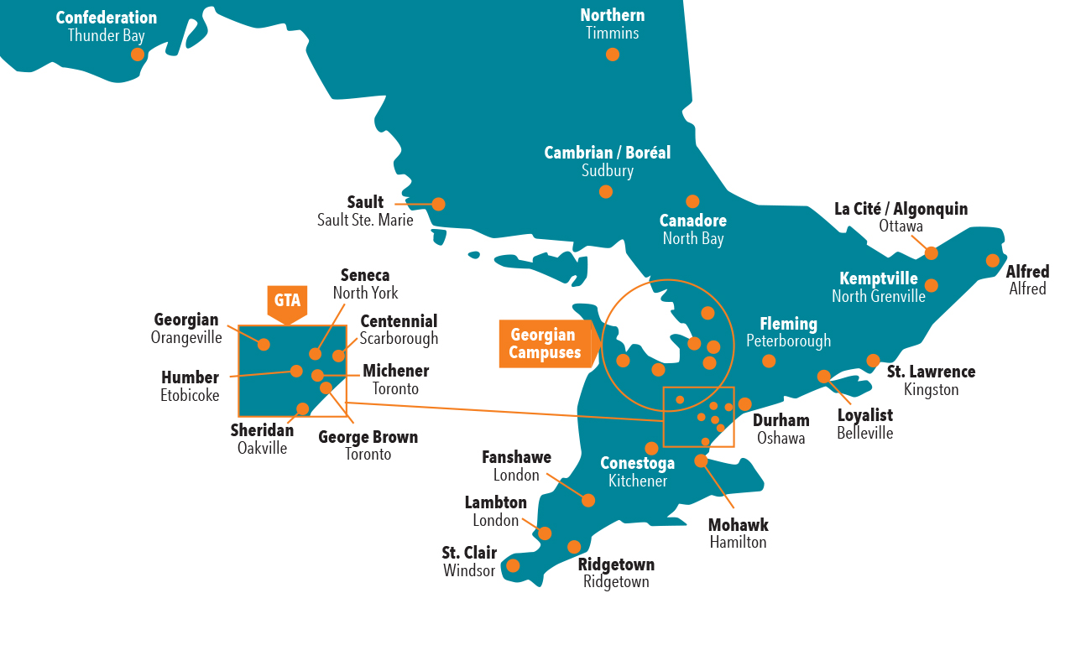

ONTARIO COLLEGES

Slide 9

Pathways from high school
0
1
2
3
4
5
1-year
Certificates
Then you can transfer into a college or university degree program
If you only have C level credits
2-year
Diplomas
C credits
3-year
Advanced diplomas
Apprenticeship – approx 2 to 5 years depending on the trade
4-year Bachelor’s Degree
U/M credits
Bachelor’s degree
Diploma
or Degree
Graduate
Certificate

Slide 10


Our Application
ontariocolleges.ca

Slide 11



Our Degrees
Career Focused
Research &
Entrepreneurship
Experiential Learning

Slide 12


Honours Bachelor of
Business Administration
(Automotive Management)

Slide 13

Honours Bachelor of
Business Administration
(Golf Management)

Slide 14

Honours Bachelor of
Business Administration
(Management and Leadership)

Slide 15
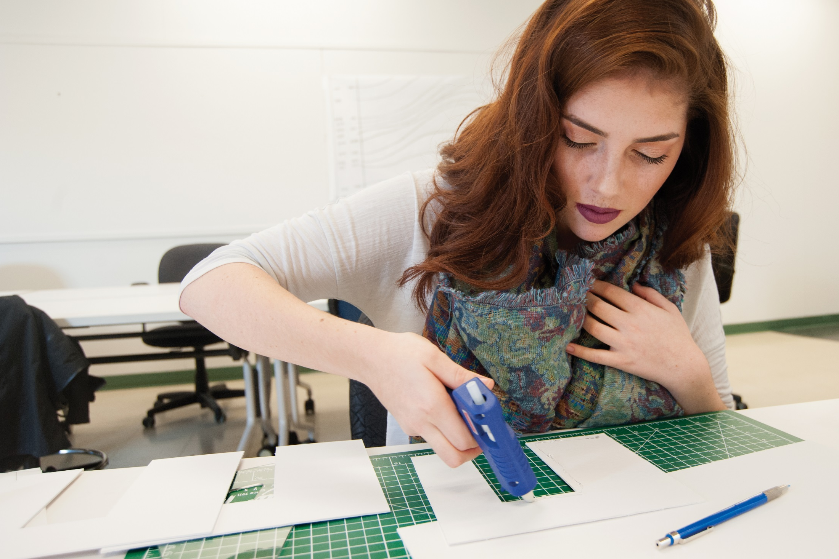
Honours Bachelor of
Interior Design

Slide 16

Honours Bachelor of
Police Studies

Slide 17


Bachelor of
Science in Nursing
(BScN) Collaborative Program

Slide 18

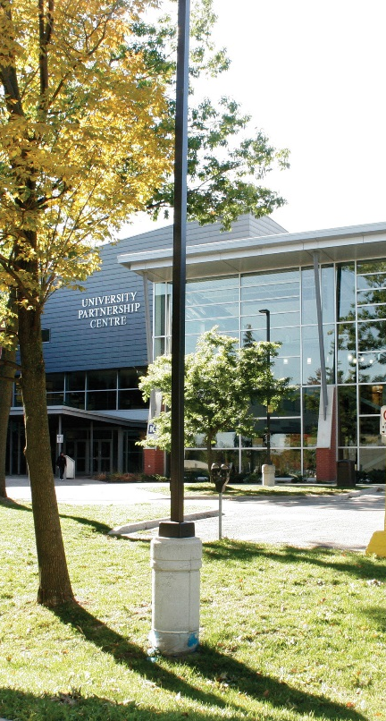
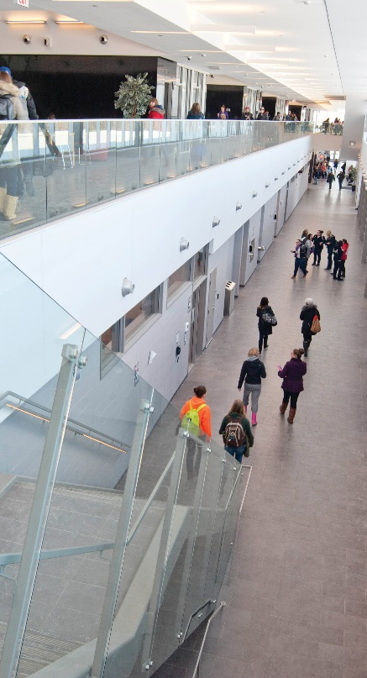
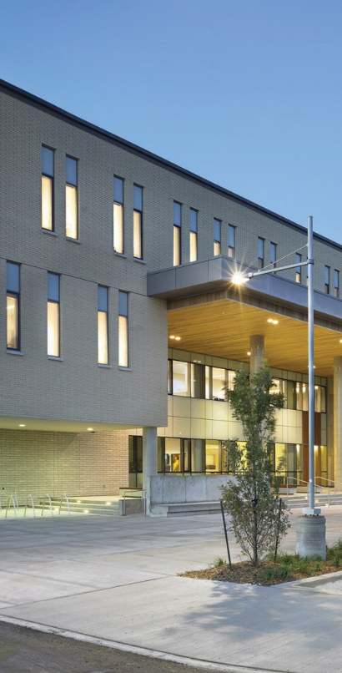

Lakehead-Georgian partnership
Get a diploma and a degree in four years

Slide 19


Get a diploma and a degree in four years
Bachelor of Engineering (Electrical) degree
with Electrical Engineering Technology
advanced diploma
Honours Bachelor of Arts and Science
– Environmental Sustainability
(Specialization in Ecosystem Management) degree with Environmental Technician diploma

Slide 20


Get a diploma and a degree in four years
New programs beginning September 2018
Honours Bachelor of Science in
Applied Life Sciences degree with
Biotechnology – Health diploma degree
Honours Bachelor of Science in
Computer Science degree with
Computer Programmer diploma

Slide 21
College to University Pathways
There are many college/university articulation agreements offered now, and in some cases it may actually save you some money…like this example:
BUSINESS MANAGEMENT
4 years at university
= $31,849.48*
3 years at college
+ 2 years at university
= $25,398.33*
$6,451.15* difference
Source: Fall 2103/Winter 2014 Domestic Tuition and Fees for Ryerson and George Brown
Subject to change by institution and by year

Slide 22
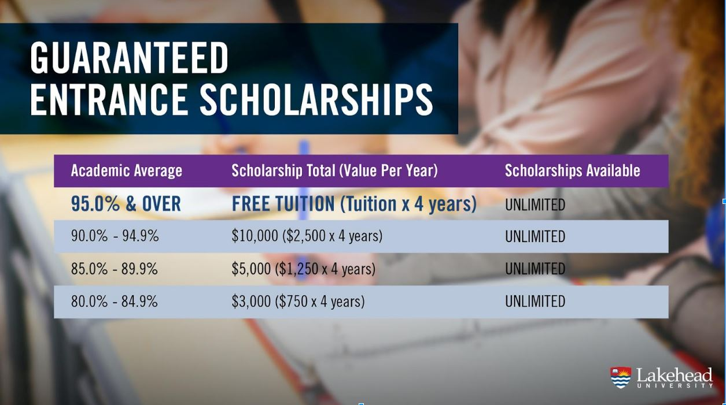

Slide 23

Connect with us
SATURDAY:
APRIL 14
All seven campuses
BY APPOINTMENT:
All seven campuses
March Break workshops
Book online (RSVP required)
CONTACT US:
recruitment@georgiancollege.ca
705.722.5152
JOIN OUR MAILING LIST:
GeorgianCollege.ca/about-Georgian/mailing-list/

