Slide 1
Dual Credits & Co-op

Slide 2
What is a dual credit?
Dual credit programs allow students, while they are still in secondary school, to take college or apprenticeship courses that count towards both their OSSD and a post-secondary diploma or Certificate of Apprenticeship.
They are college-level courses that assist students with making a successful transition to college and/or apprenticeship programs in addition to helping them complete their OSSD.
Primary target audience is students who face significant challenges in completing the requirements for graduation but who have the potential to succeed. OYAP and/or SHSM students are also eligible to participate in dual credits.
Dual credits are either college-delivered (students attend class on a college campus) or team-taught (course is delivered in a high school and content is delivered by both a college instructor and a secondary school teacher)

Slide 3
How do students access dual credits?
Recruitment of students takes place through the school boards.
Students must go through their school’s guidance department to apply for dual credit or they may be referred by a secondary school teacher.
Guidance counsellors and student success teachers submit applications for senior students who meet the criteria of being disengaged, underachieving, at risk of not graduating or facing personal barriers, or who are in OYAP or an SHSM program.
A central school board representative then vets the applications to ensure that seats are given to students who are in the primary target audience.

Slide 4
Dual credit policy
Cooperative education programs are mentioned in the dual credit policy document.
A college-delivered dual credit course cannot be the related course in a cooperative education program;
The scheduling conflicts that may arise if a student is taking a college-delivered dual credit may be alleviated if the student is also taking one or more credits through cooperative education. With the approval of the co-op teacher and the workplace supervisor, students can arrange to complete the in-school class and work placement hours for the co-op at alternative times;
Dual credit classroom time cannot be applied towards work placement hours.

Slide 5
Level 1 apprenticeship opportunities
Level 1 General Machinist (Barrie, SMCDSB/SCDSB)
8 week block delivery May – June
Students start the semester in co-op
Level 1 Carpentry (Bracebridge, SMCDSB/TLDSB/SCDSB)
8 week block delivery May – June
Students start t he semester in co-op
Level 1 Cook (Owen Sound, BGCDSB, BWDSB)
5 month delivery
Combination of college class time and co-op placement
Level 1 Hairstylist (Barrie, SMCDSB/SCDSB/TLDSB)
Once per week for 10 months
Students may be in co-op and/or taking regular classes at high school

Slide 6
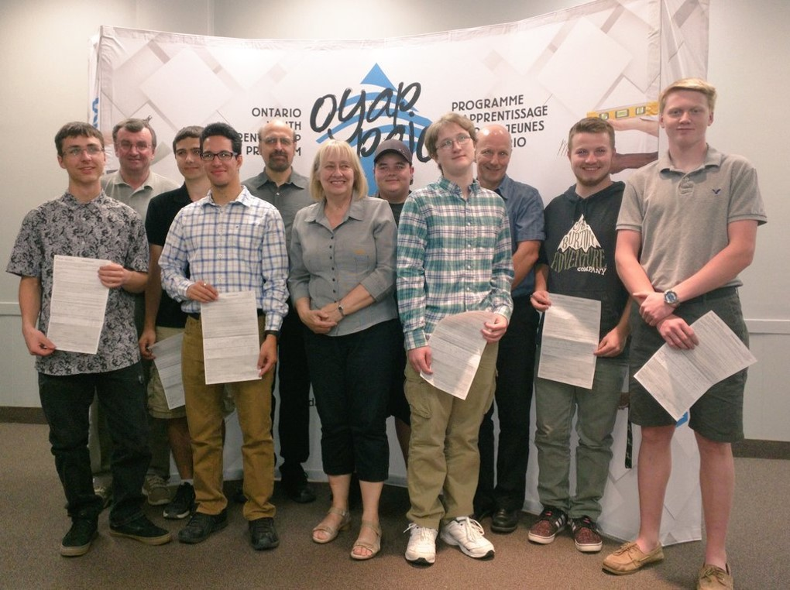
level 1 general machinist
“I did a 4 credit co-op in semester 2 and then did my level 1 at Georgian College in the spring. The math was definitely an eye-opener but it prepared me to go back to my employer for the summer with new skills. I had a lot more to bring to the table for my boss.” Tyler, Level 1 Machinist

Slide 7
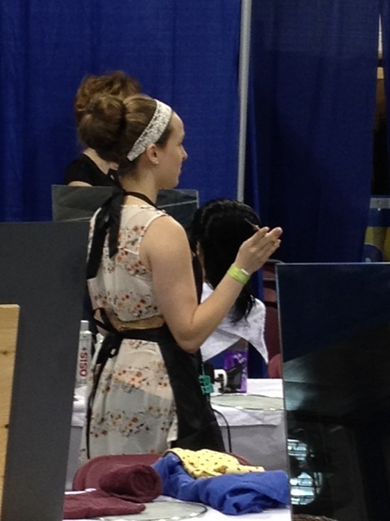
Level 1 hairstyling
“I attended my Level 1 hairstyling course once a week for a full school year in my last year of high school. It was intense. But now I’m set to do my Level 2 and I should be working as a fully licensed stylist by the time I’m 19 years old. One day I hope to have my own salon.”
Taylor, Level 1 Hairstyling

